Slide 1
WHAM update 24 Sept

Slide 2
Given error in fall VAST and NEAMAP indices where inadvertently did not remove YOY….
For recent runs, used RecCPA and Spring VAST indices (Tim)
Exploring sensitivities where added fall VAST index (Alex and Kiersten)
Rerunning some of the previous model runs (Kiersten)

Slide 3
Explore age comp distribution assumptions….
Run 19: Dirichlet distribution for age comps, estimate RecCPA CVs.
Run 20: Same as Run 19 except use Dirichlet-multinomial for age comps with max sample sizes set to 1000;
Initially tried logistic normal with and without AR1 assumption, but no convergence

Slide 4
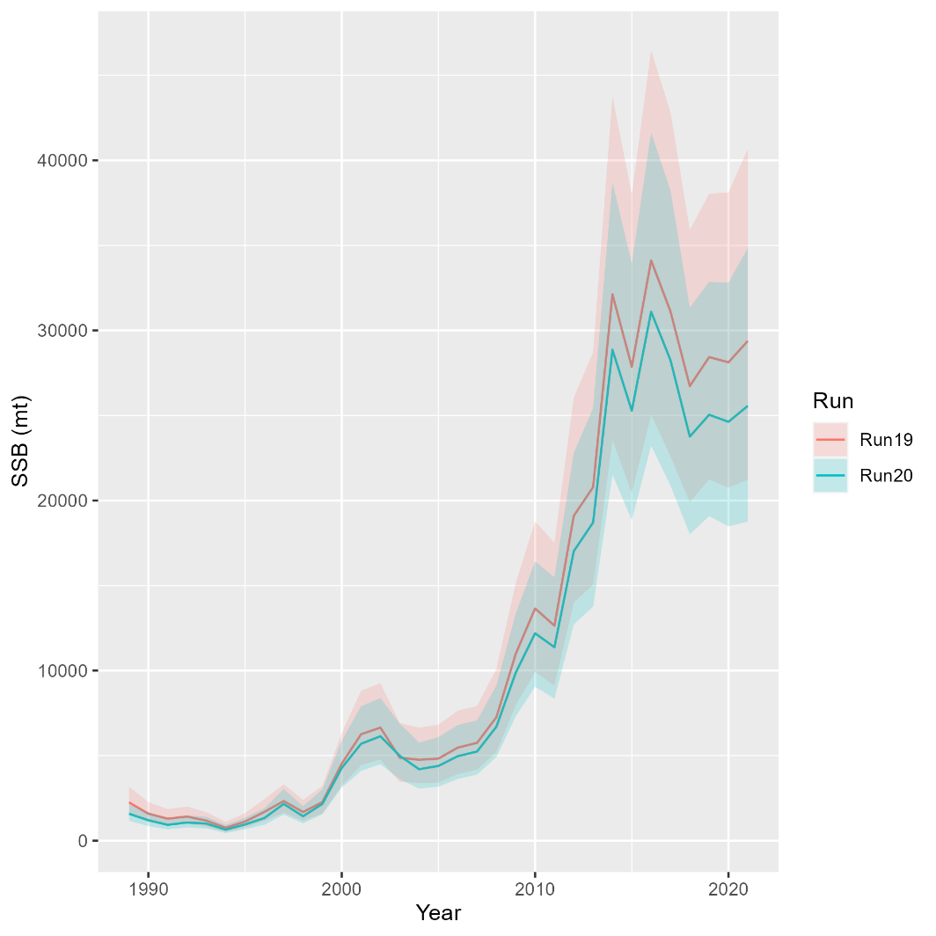
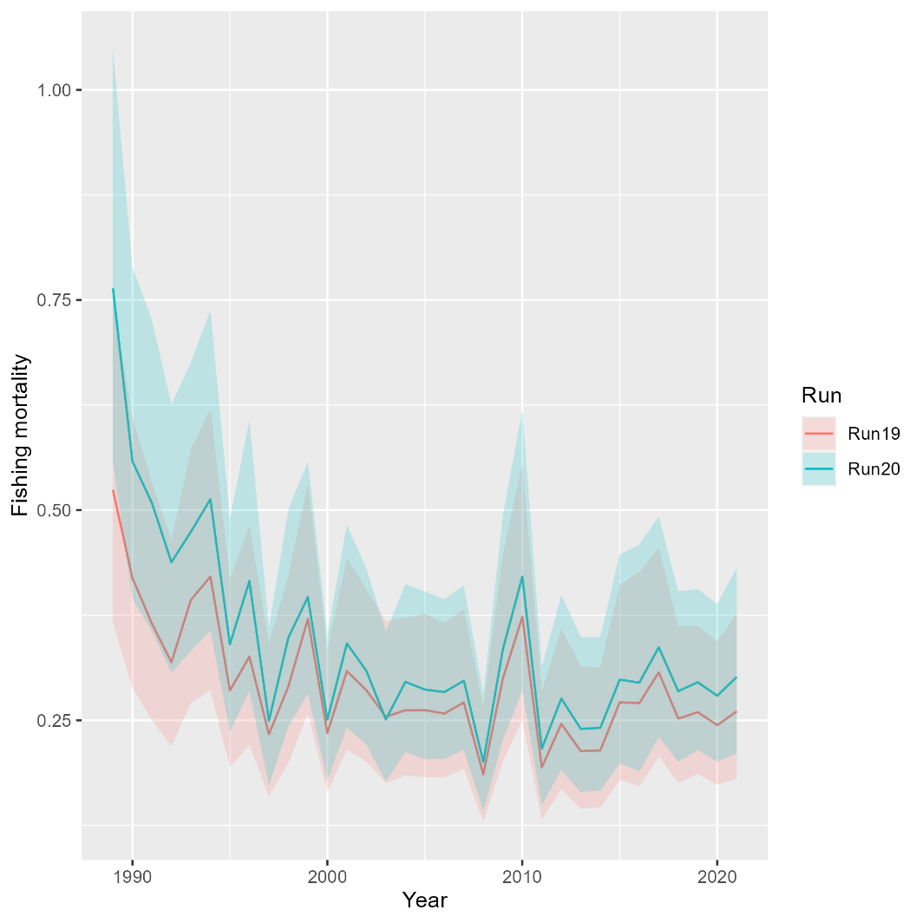
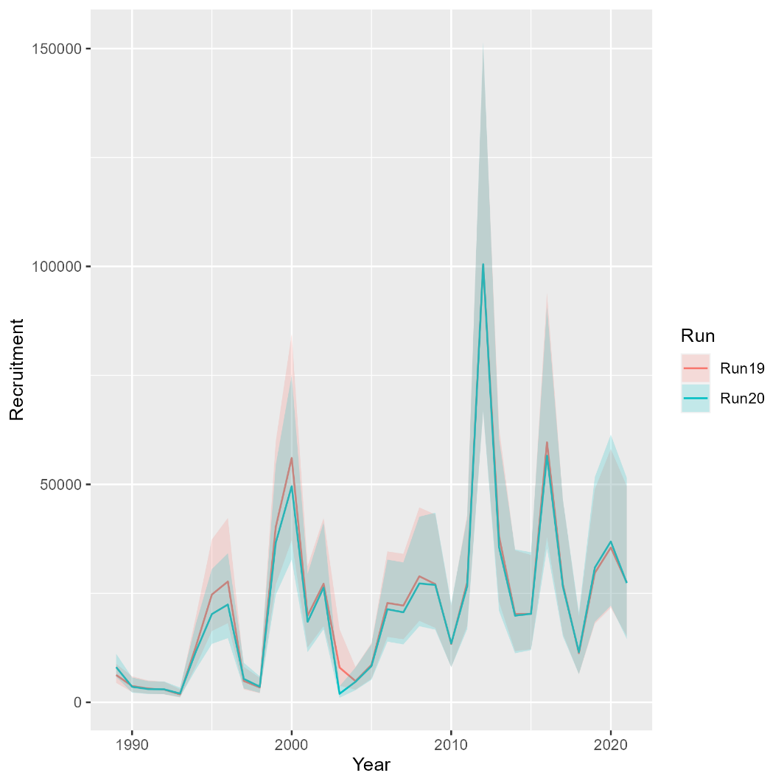
Runs 19-20: Change in age composition distribution assumption
Mohn’s rho
 | Fmort | SSB | Rect
Run19 | 0.143 | -0.145 | -0.145
Run20 | 0.161 | -0.152 | -0.133
North

Slide 5
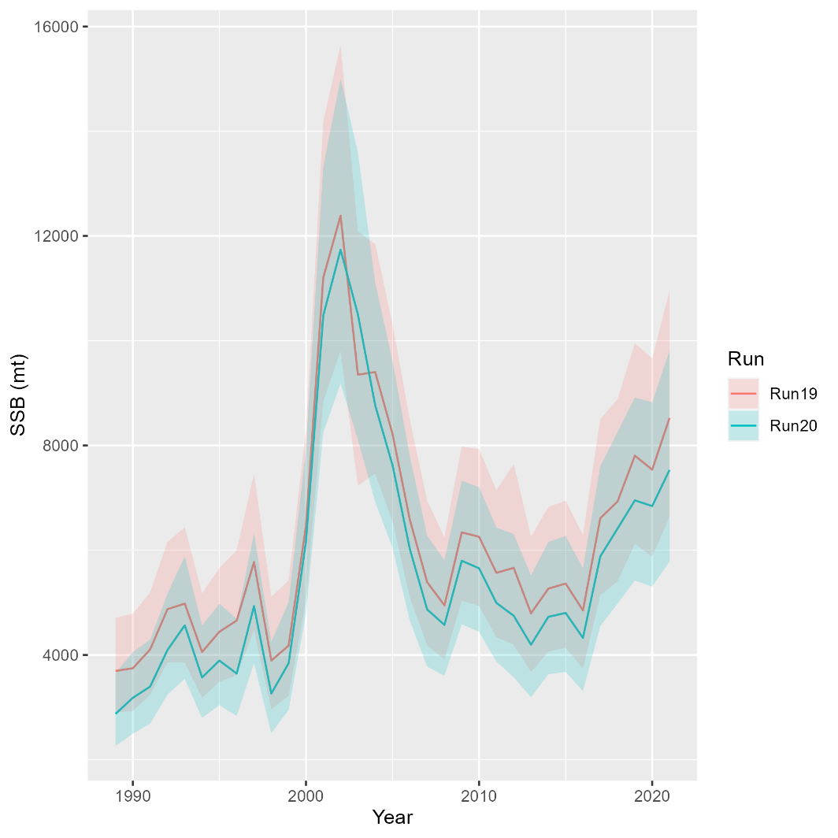
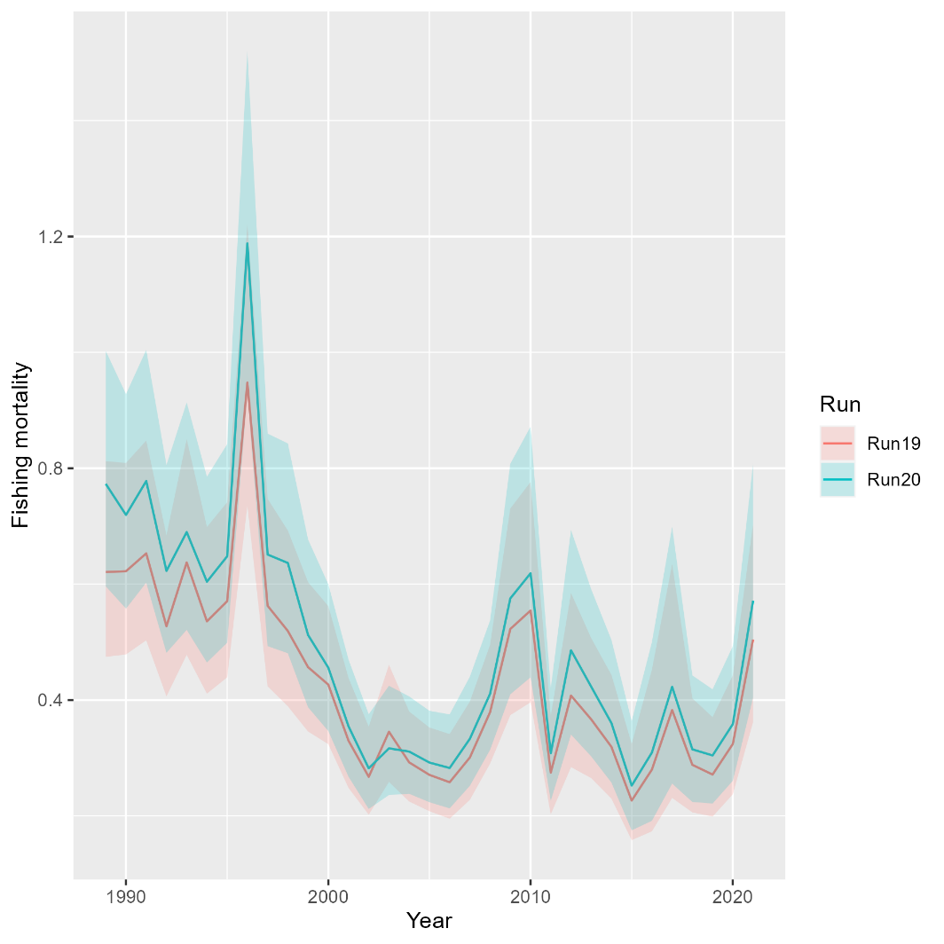
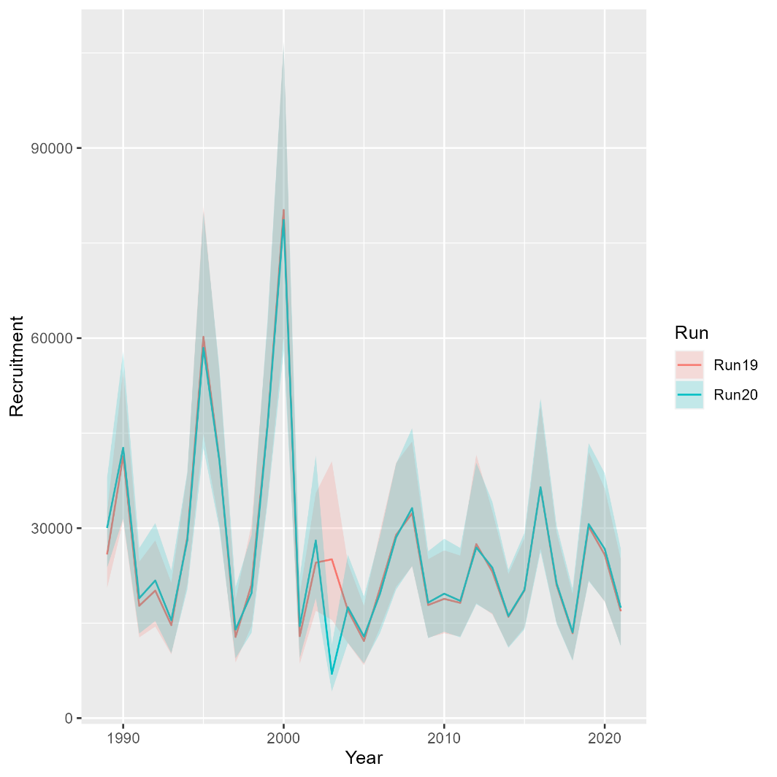
Runs 19-20: Change in age composition distribution assumption
Mohn’s rho
 | Fmort | SSB | Rect
Run19 | 0.042 | 0.027 | 0.01
Run20 | 0.036 | 0.025 | 0.009
South

Slide 6
Explore selectivity….
Run 21: Run 20 but AR1 time-varying selectivity for north VAST index; Tried time-vary selectivity for south and on rec fleet as well but it did not converge
Run 22: time-varying selectivity for all indices, but recruitment only random effects, to get results faster. Big retros in north because of “rec” random effects.
Run 23: From Run 22 tried to expand to “rec+1” for north and/or south, but did not converge. Eventually ended up with iid random effects on all NAA and time-invariant selectivity for VAST indices but AR1 with age for south VAST. AR1 year effects for age 1 selectivity of Rec CPA

Slide 7
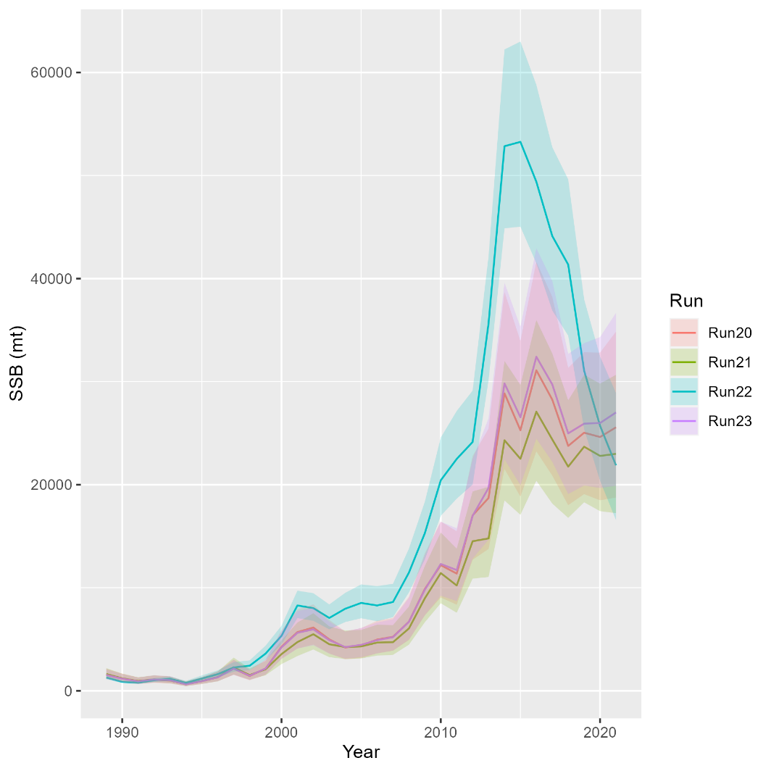
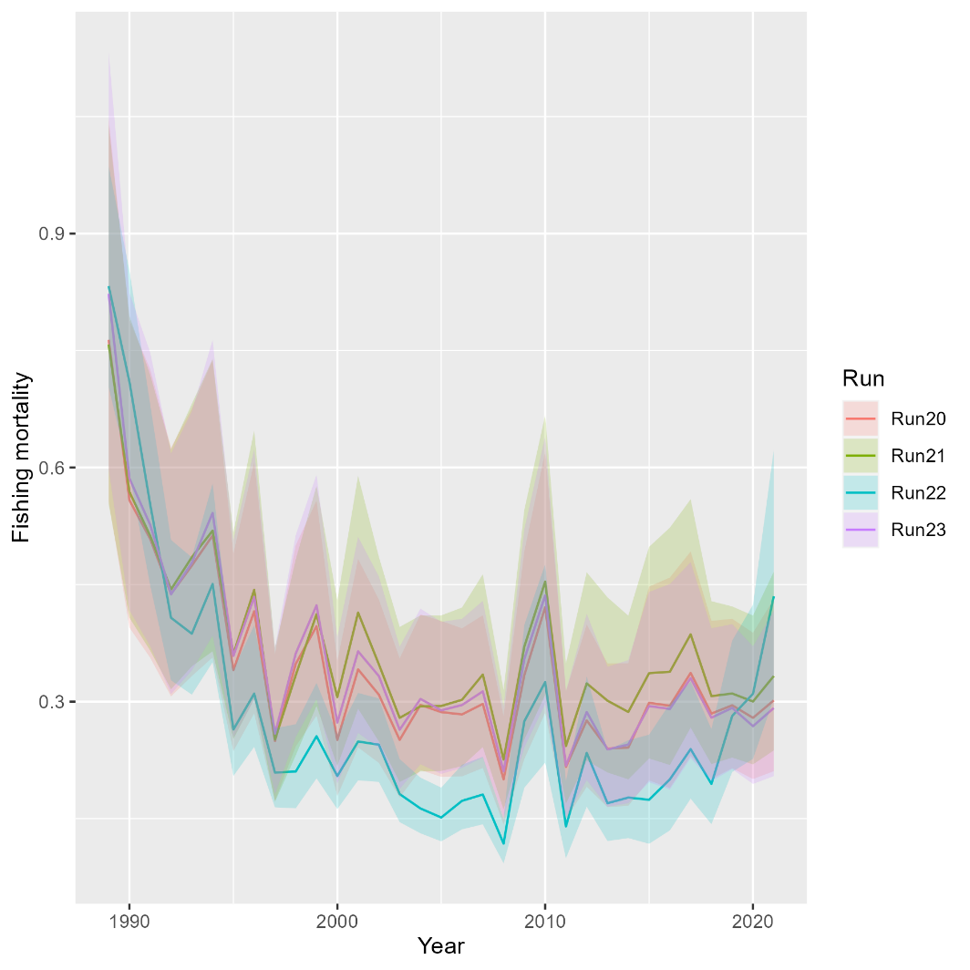
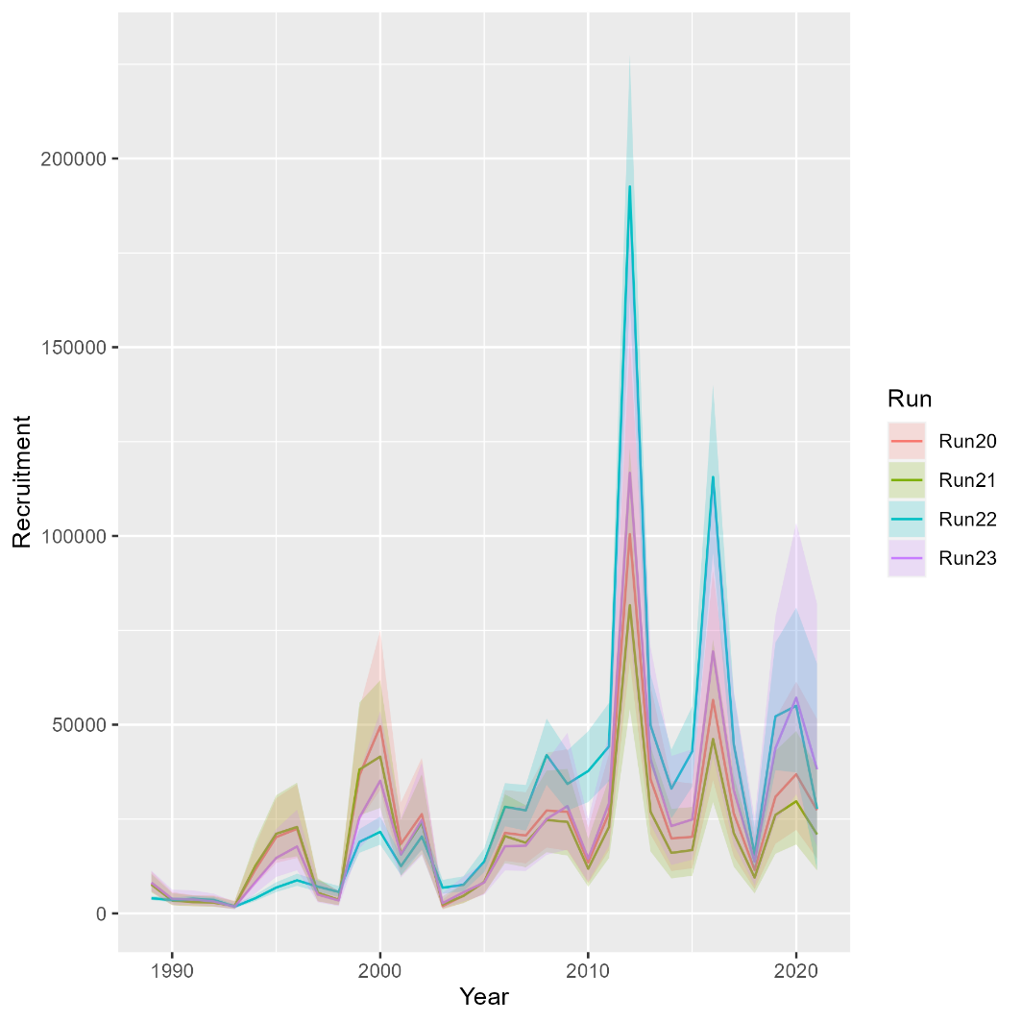
Runs 21-23: Selectivity
Mohn’s rho
 | Fmort | SSB | Rect
Run20 | 0.161 | -0.152 | -0.133
Run21 | 0.159 | -0.167 | -0.149
Run22 | 0.805 | -0.442 | -0.41
Run23 | 0.149 | -0.147 | -0.097
North

Slide 8
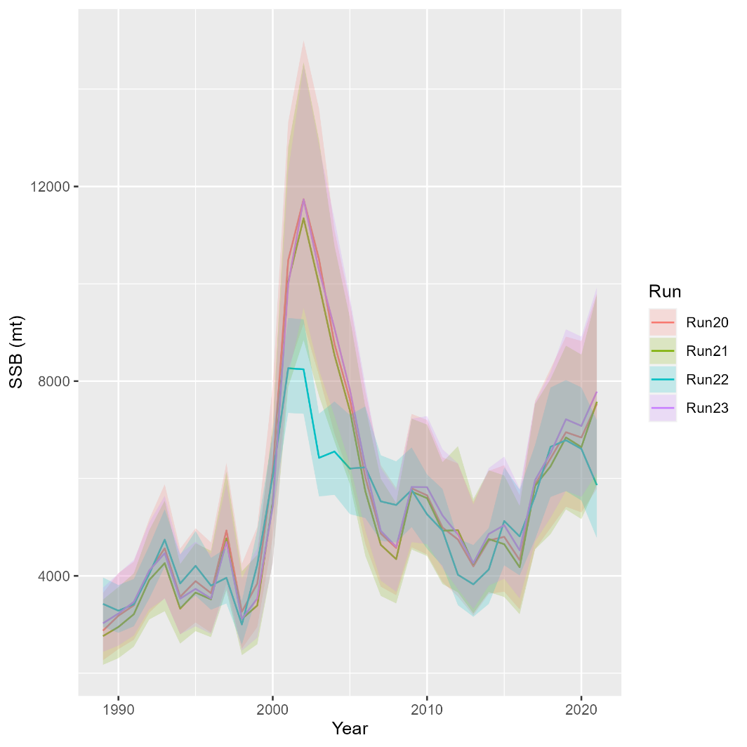
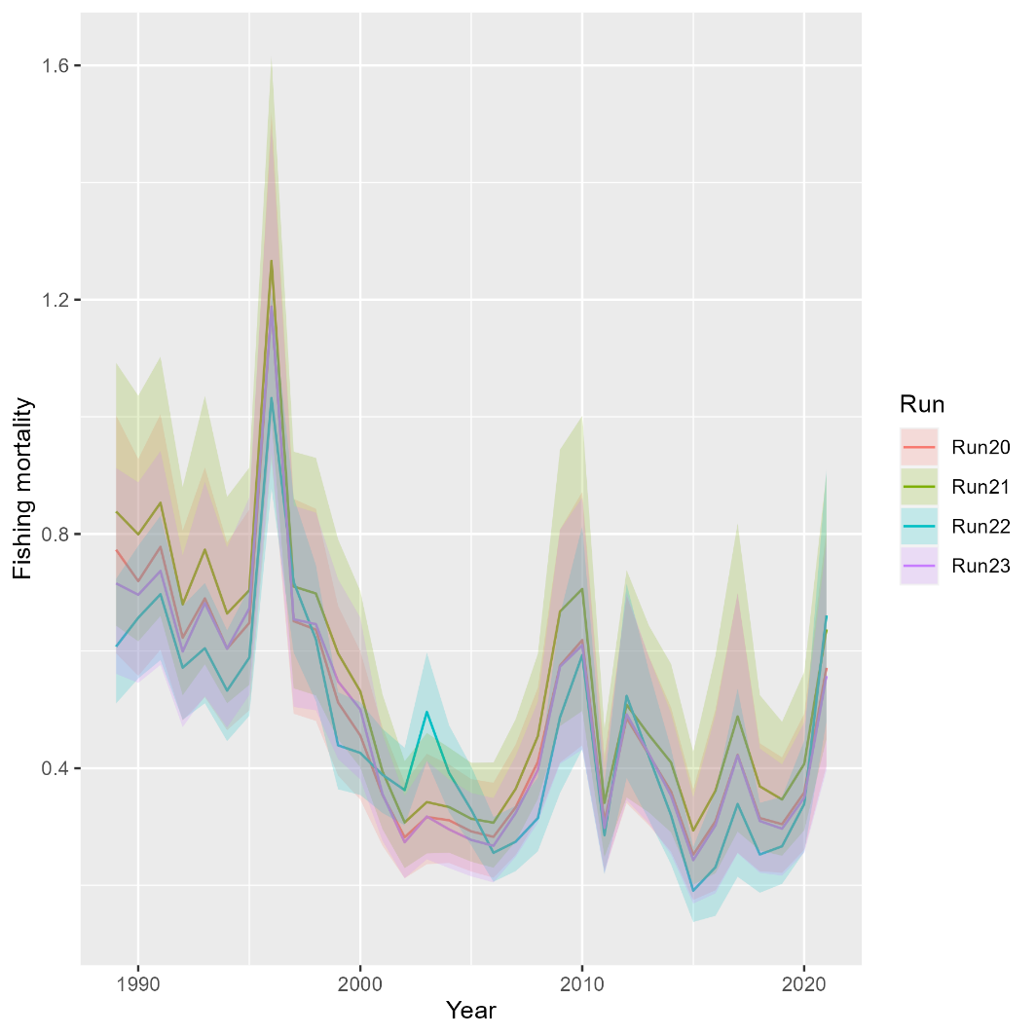
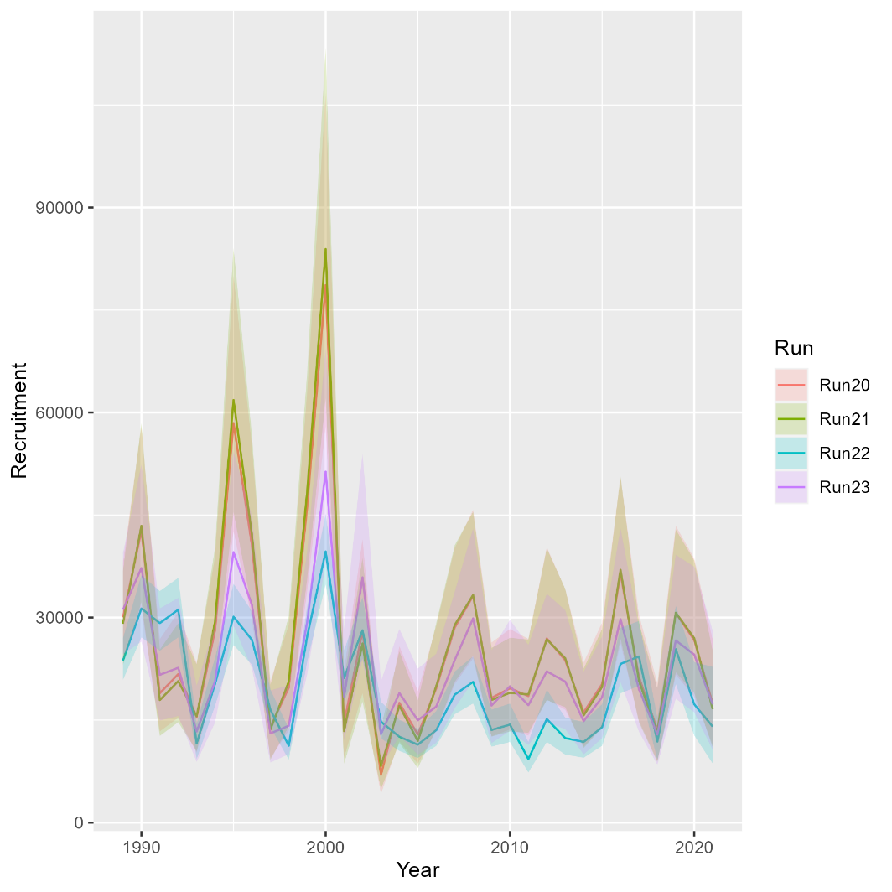
Runs 21-23: Selectivity
Mohn’s rho
 | Fmort | SSB | Rect
Run20 | 0.036 | 0.025 | 0.009
Run21 | 0.039 | 0.032 | -0.002
Run22 | 0.204 | -0.039 | -0.001
Run23 | 0.059 | 0.024 | 0.073
South

Slide 9
Explore movement….
Run 24: Run 23 but time-varying movement rate for N-S. Had to fix south Rec CPA CV at estimate from Run 23.
Run 25: Run 24 but dirichlet distribution instead of dirichlet-multinomial. Also tried logistic-normal but didn’t converge.

Slide 10
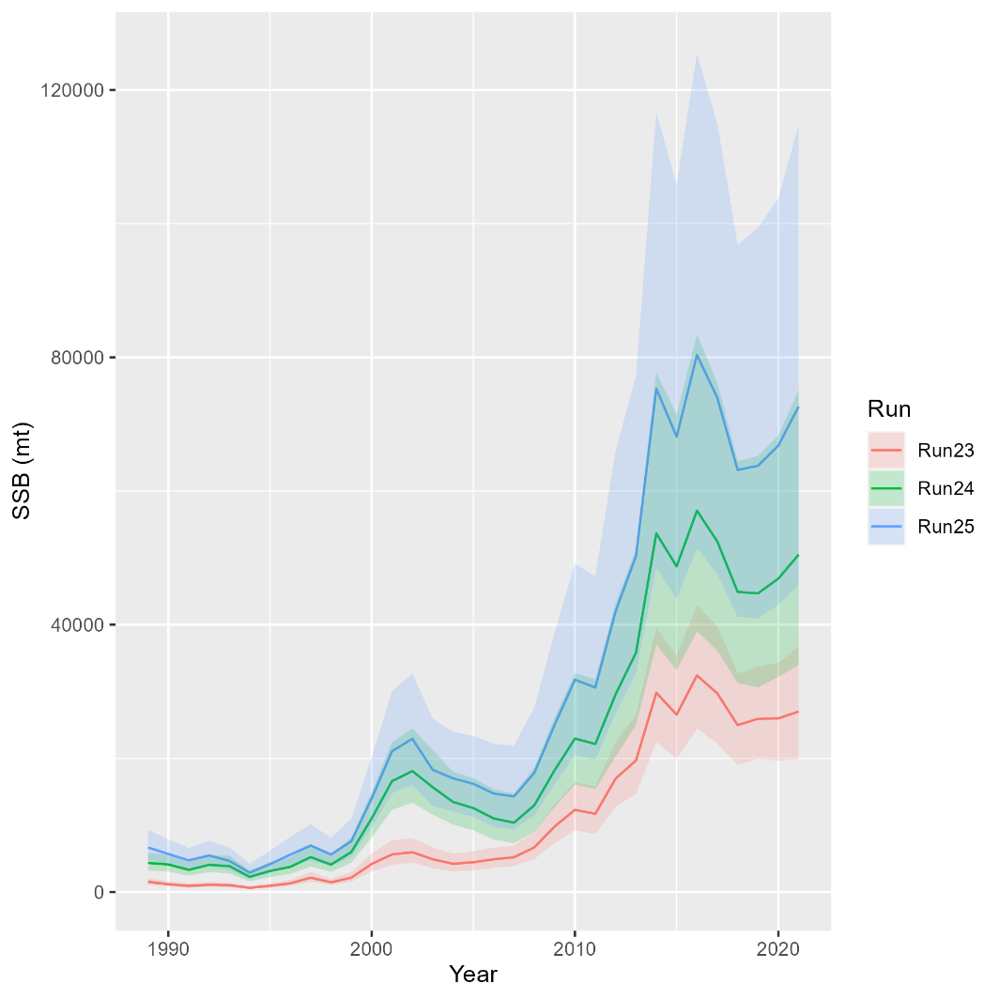
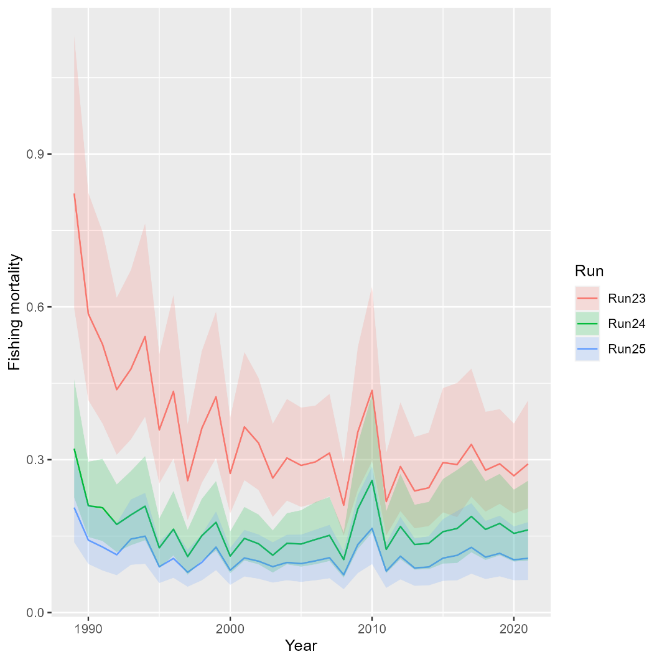
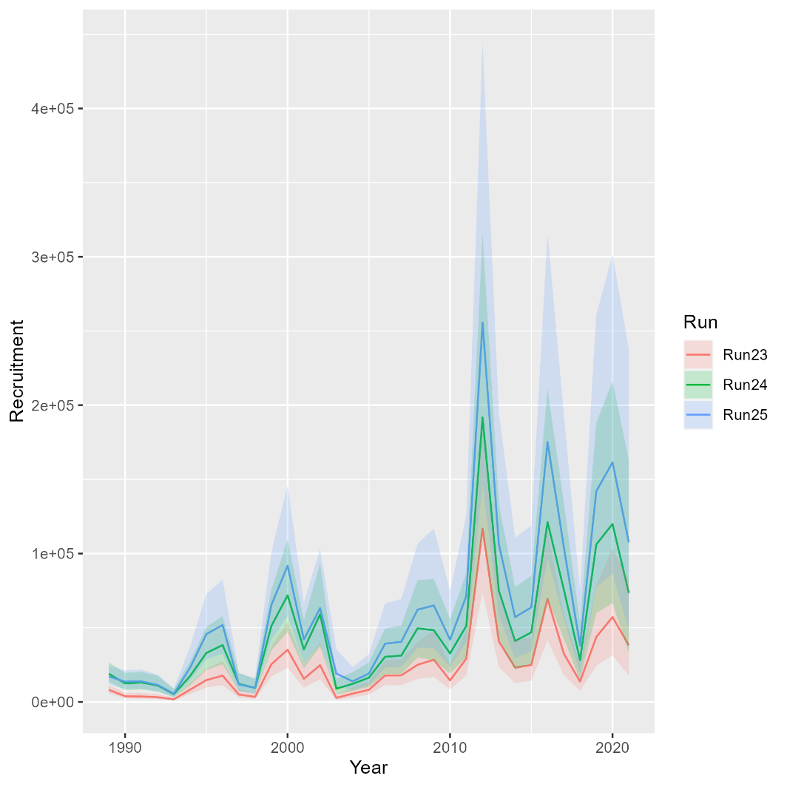
Runs 24-25: Movement
Mohn’s rho
 | Fmort | SSB | Rect
Run23 | 0.149 | -0.147 | -0.097
Run24 | 0.444 | -0.3 | -0.321
Run25 | 0.295 | -0.239 | -0.306
North

Slide 11
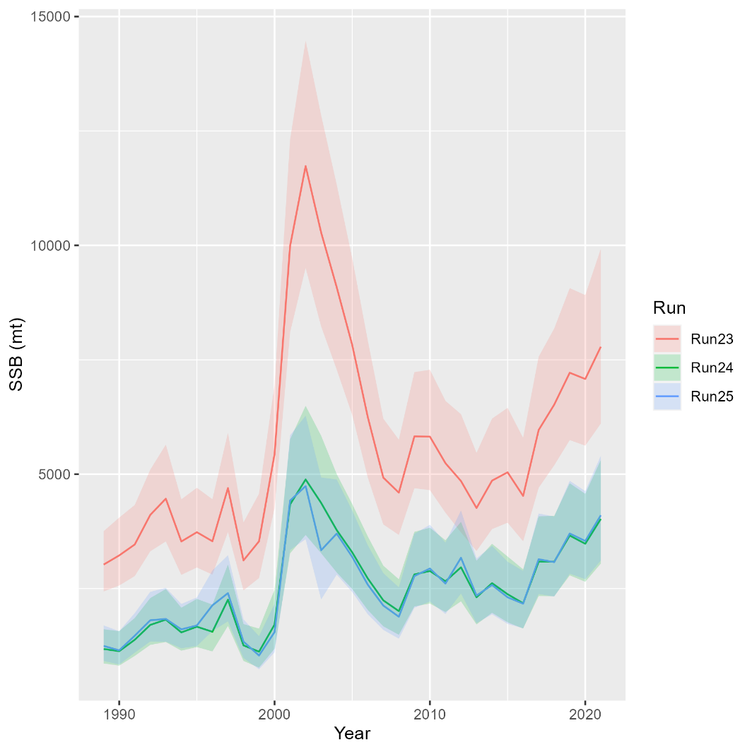
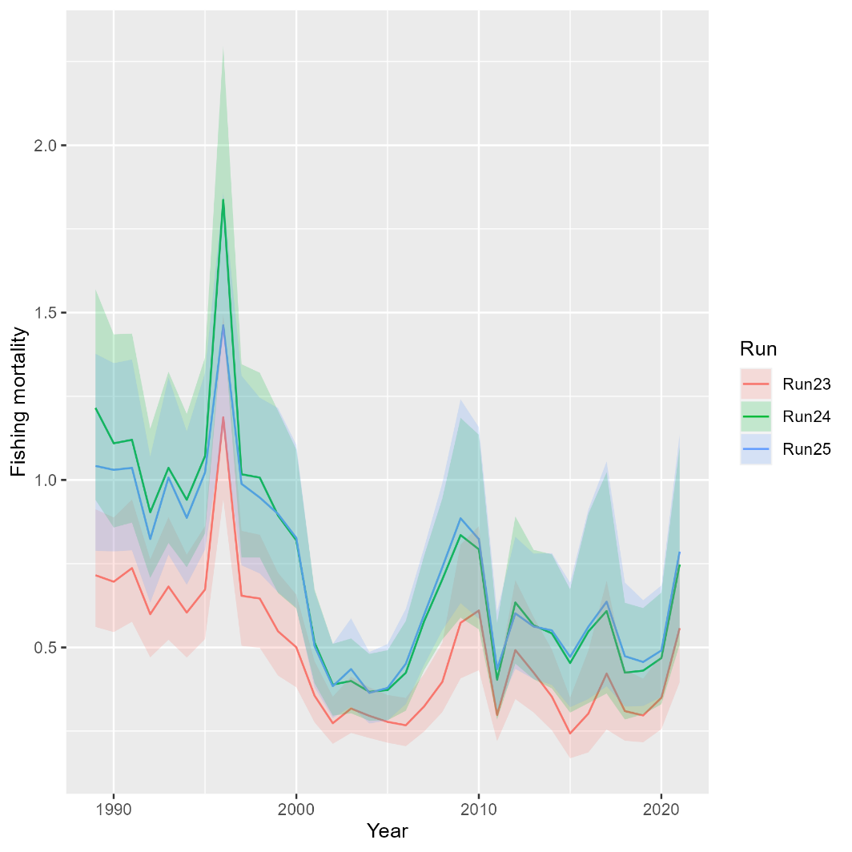
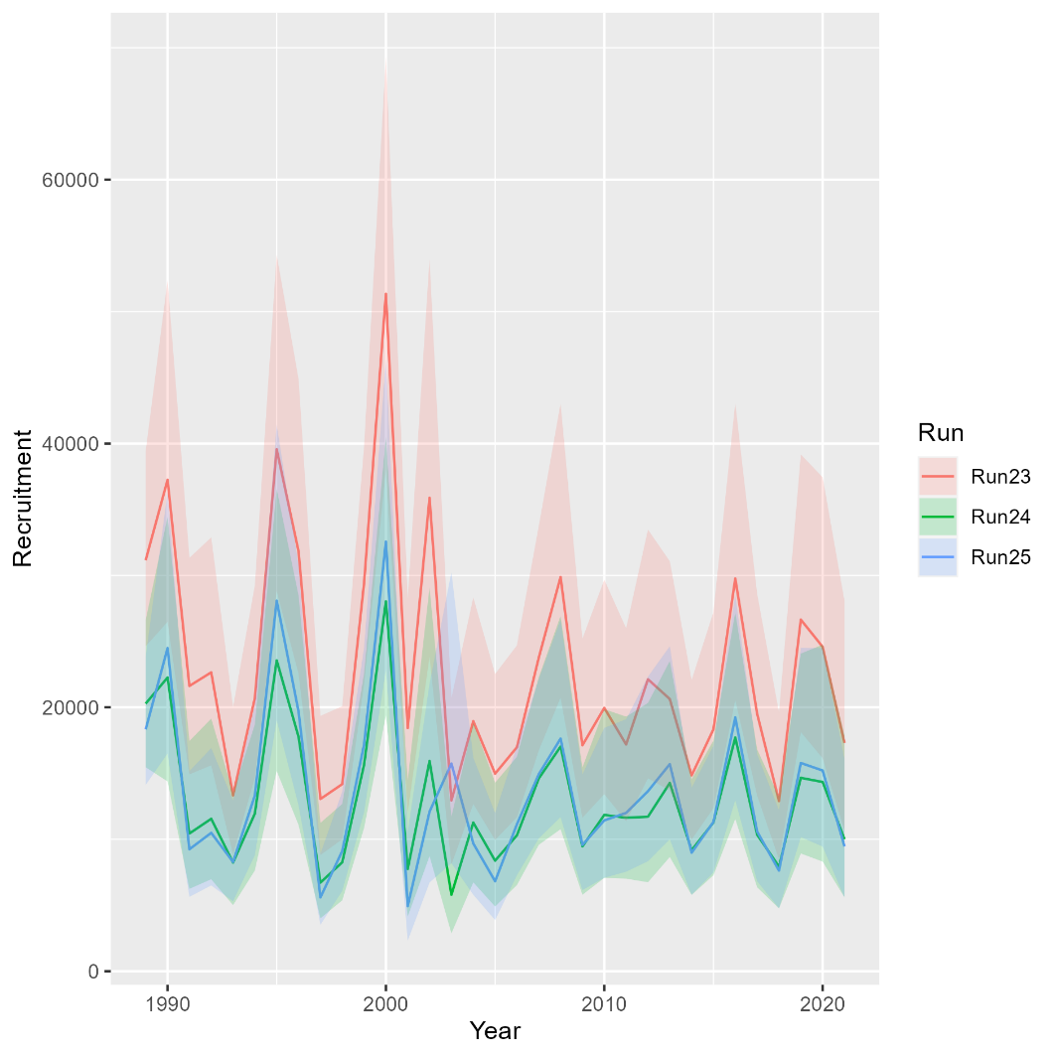
Runs 24-25: Movement
Mohn’s rho
 | Fmort | SSB | Rect
Run23 | 0.059 | 0.024 | 0.073
Run24 | 0.084 | 0 | 0.133
Run25 | 0.171 | -0.043 | 0.059
South

Slide 12
OSA Residuals: Run 25

Slide 13
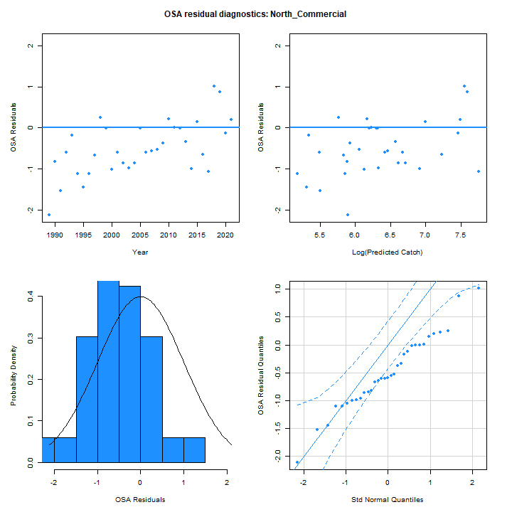
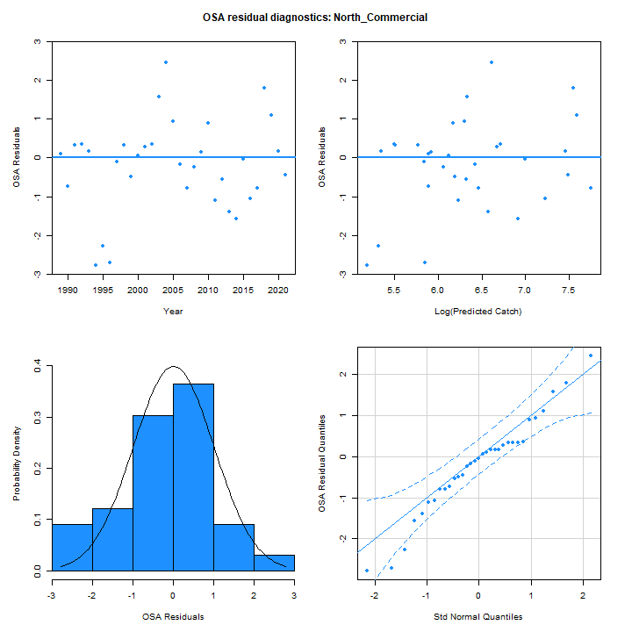
OSA Residuals
Run 25
Run 8

Slide 14
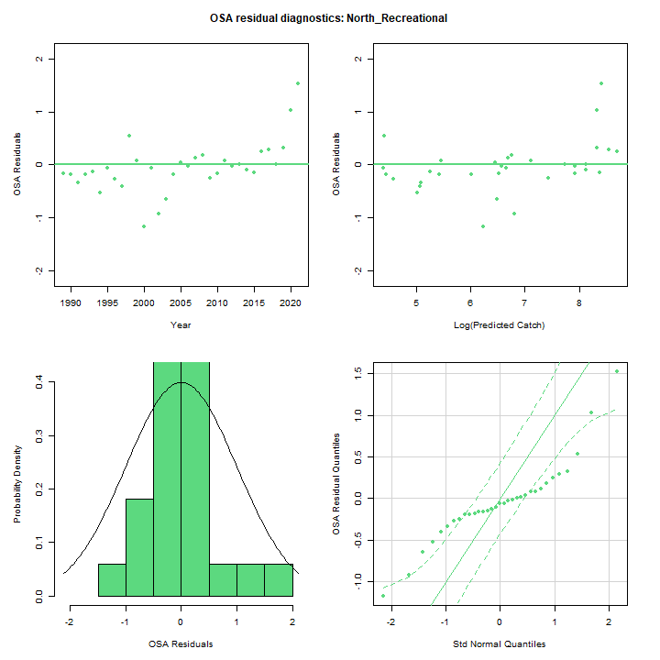
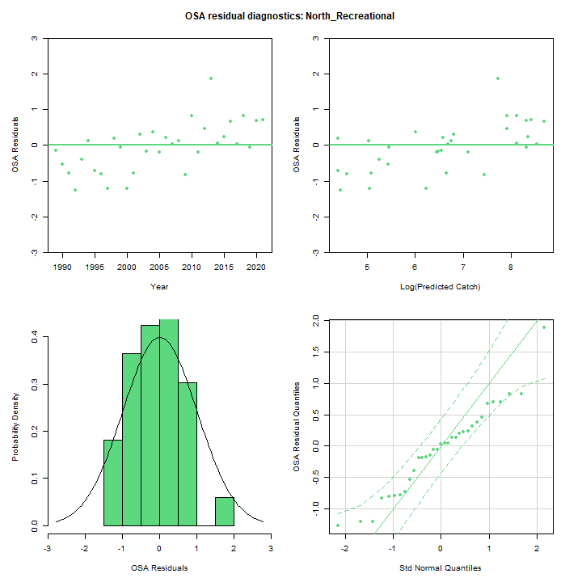
OSA Residuals
Run 25
Run 8

Slide 15
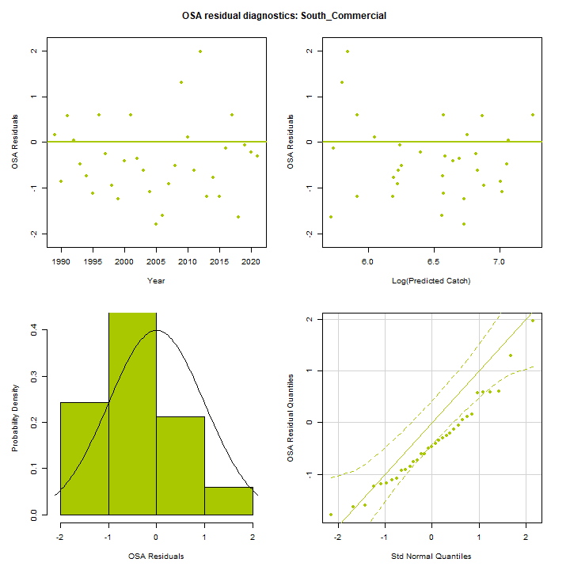
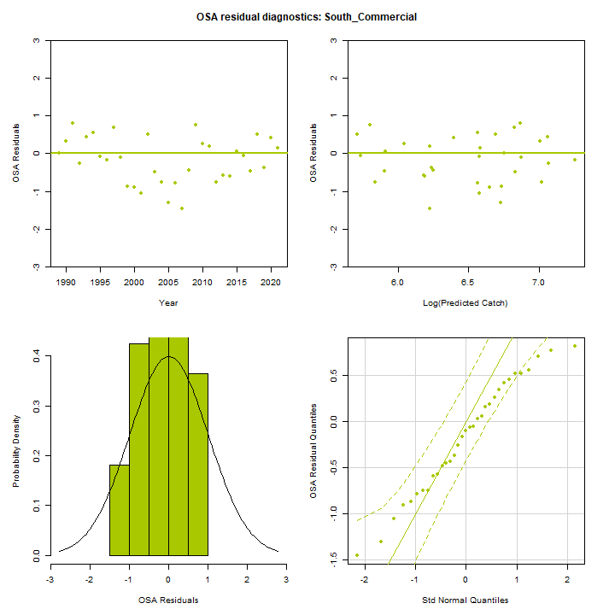
OSA Residuals
Run 25
Run 8

Slide 16
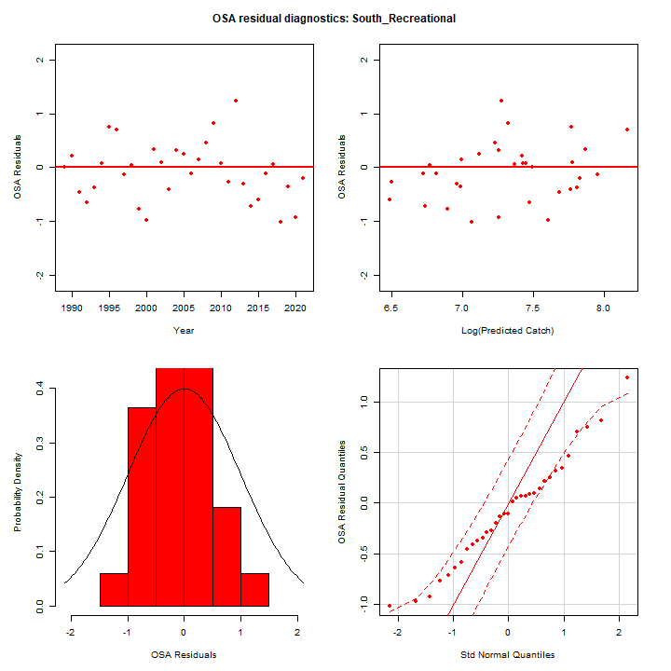
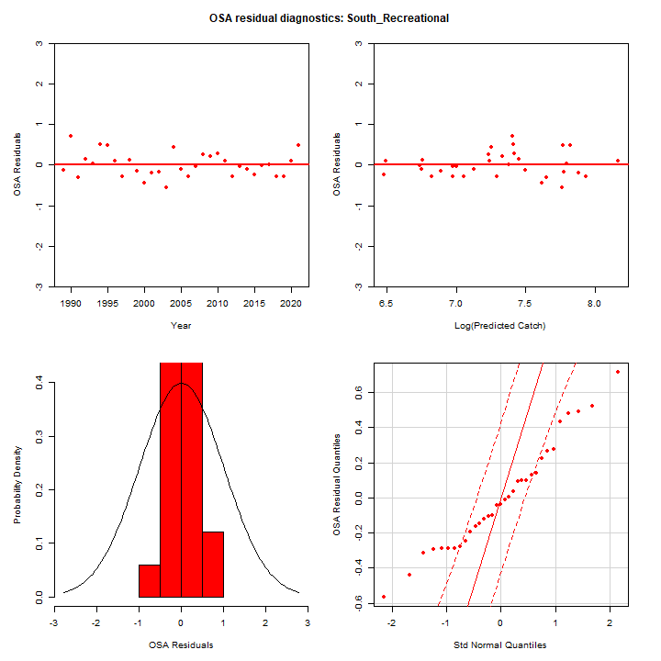
OSA Residuals
Run 25
Run 8

Slide 17
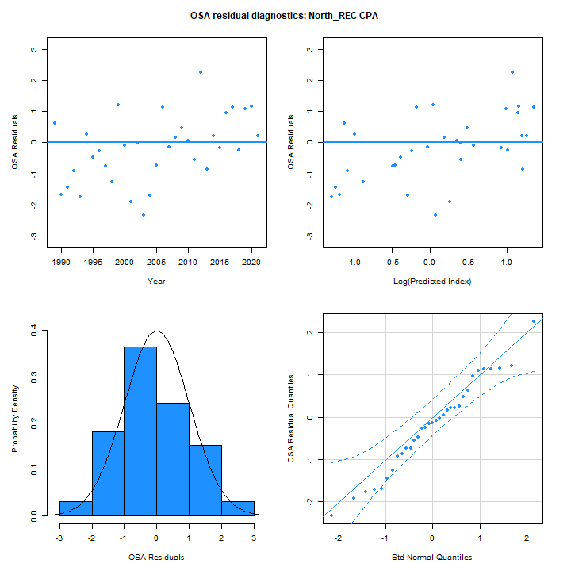
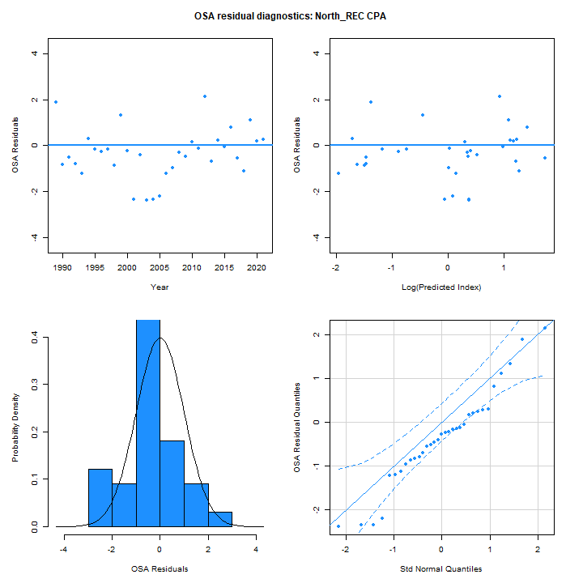
OSA Residuals
Run 25
Run 8

Slide 18
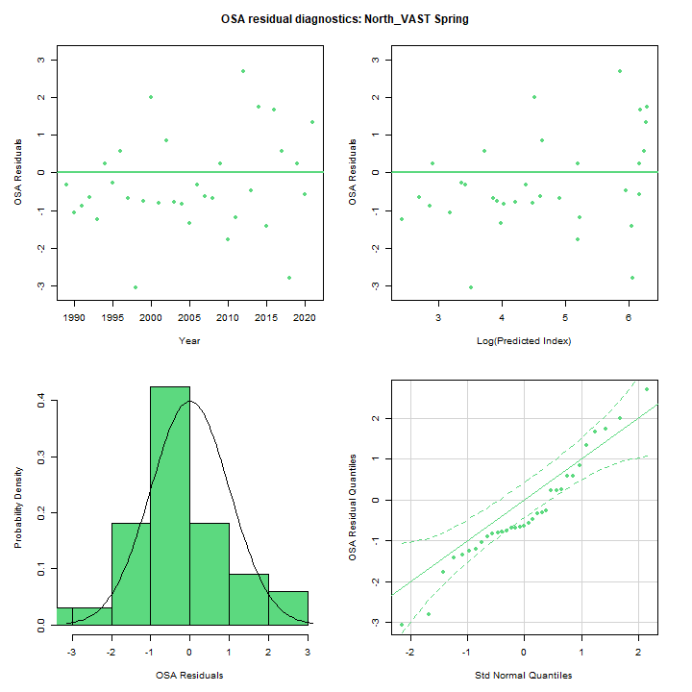
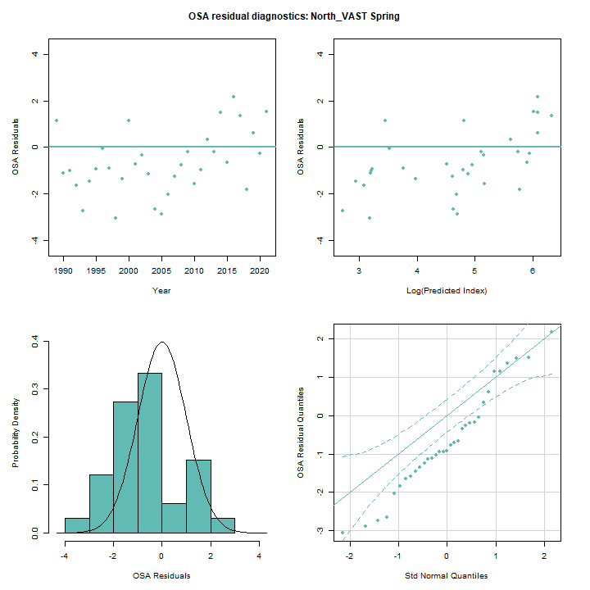
OSA Residuals
Run 25
Run 8

Slide 19
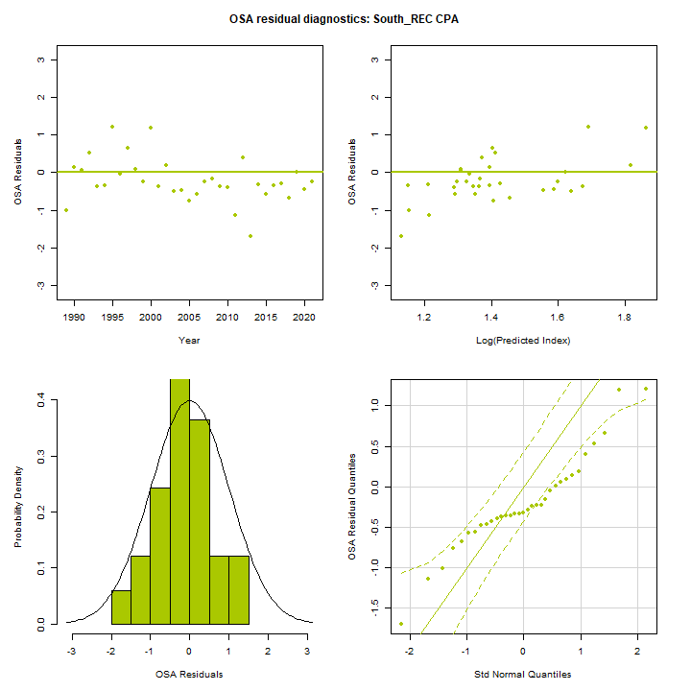
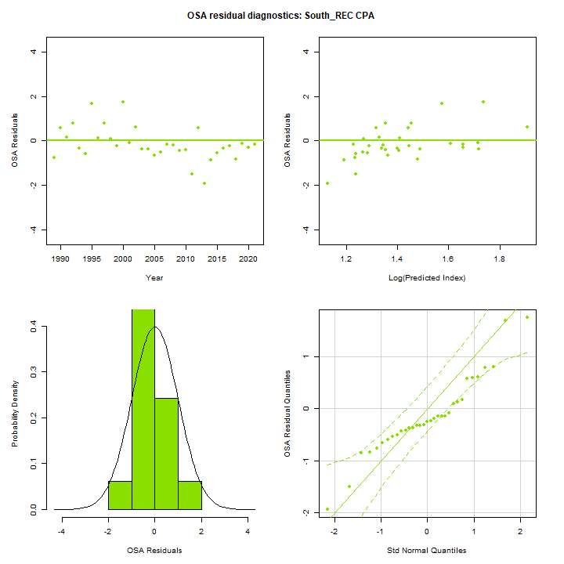
OSA Residuals
Run 25
Run 8

Slide 20
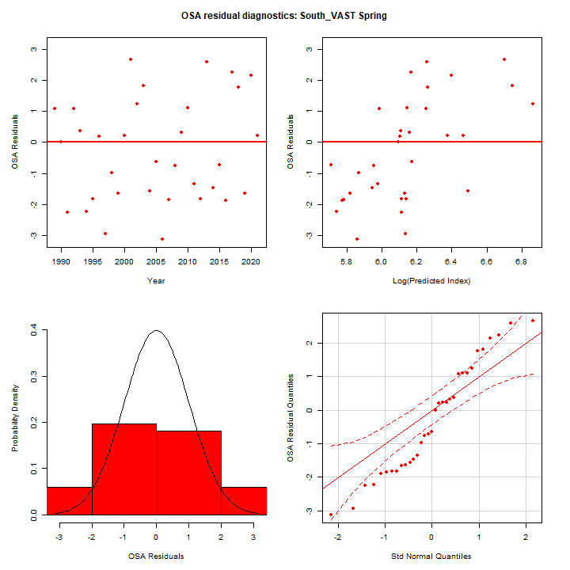
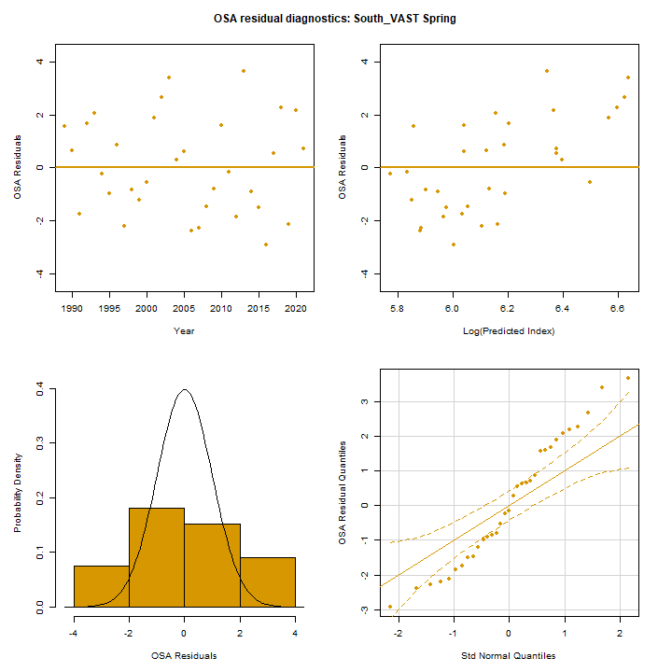
OSA Residuals
Run 25
Run 8

Slide 21
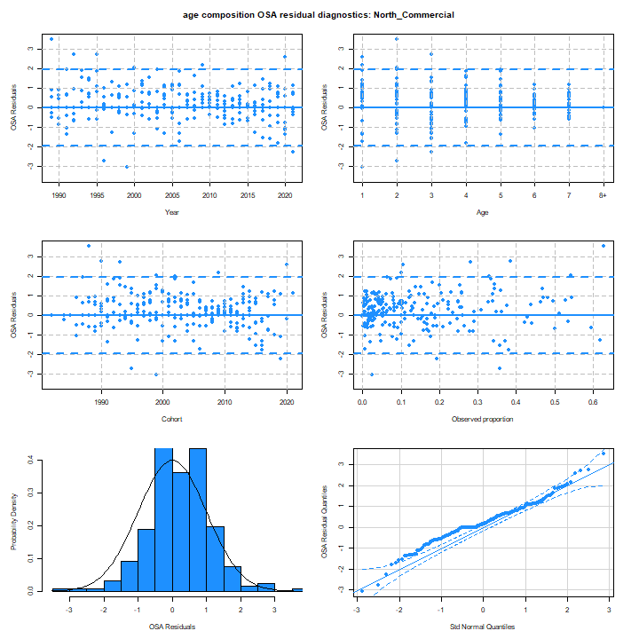

OSA Residuals
Run 25
Run 8

Slide 22
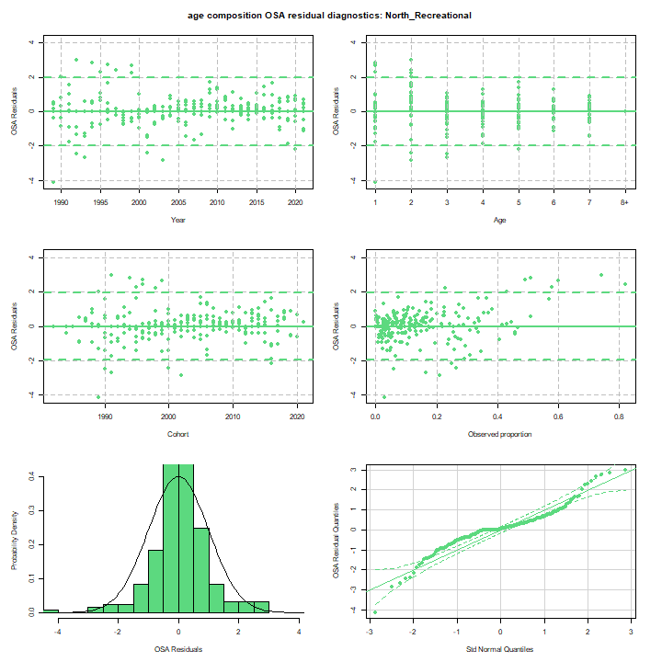
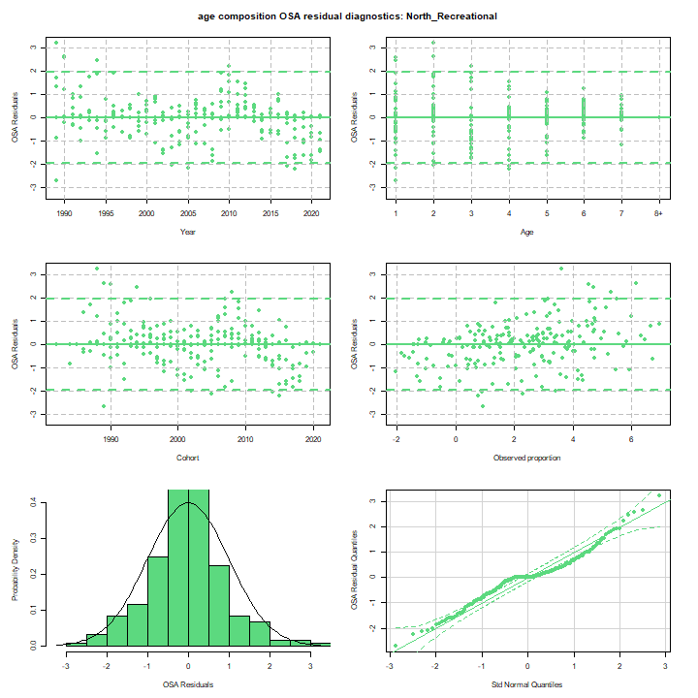
OSA Residuals
Run 25
Run 8

Slide 23
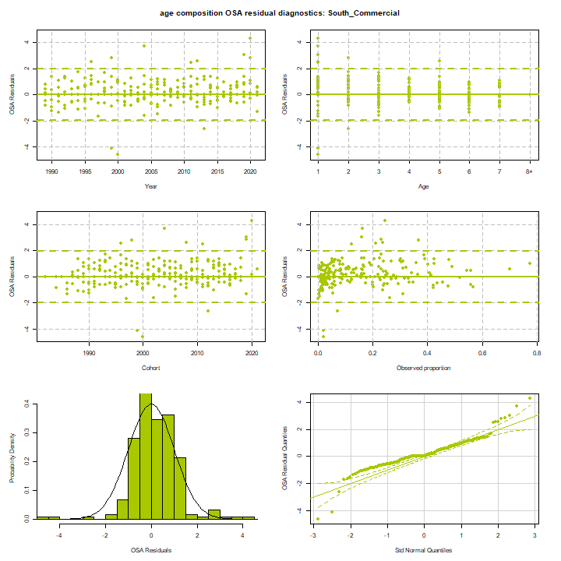
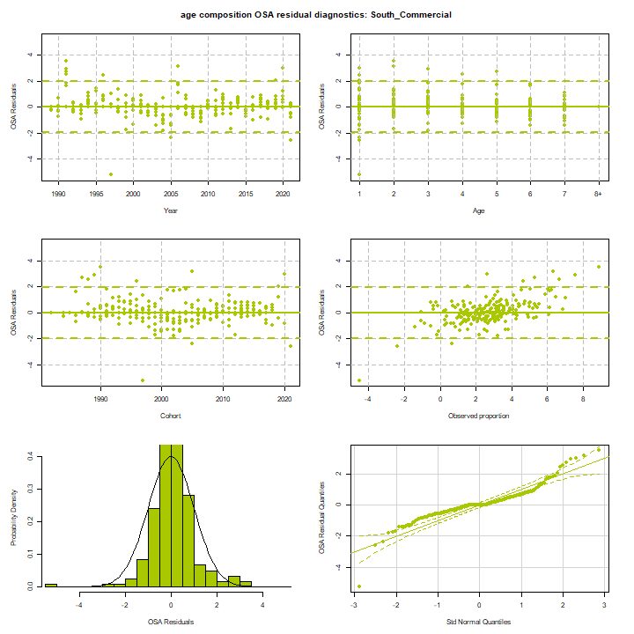
OSA Residuals
Run 25
Run 8

Slide 24
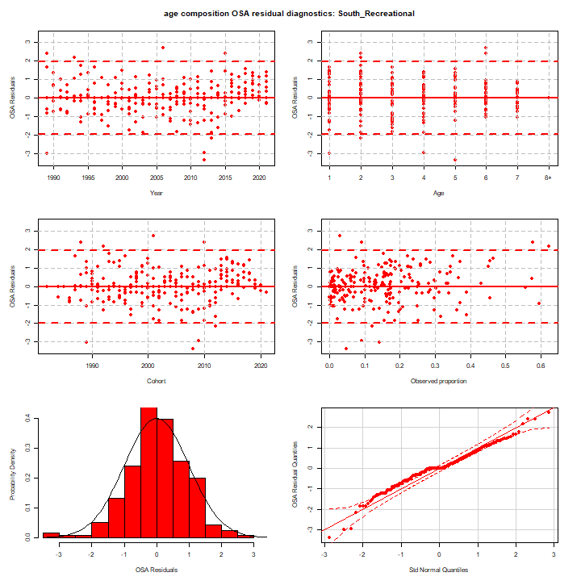
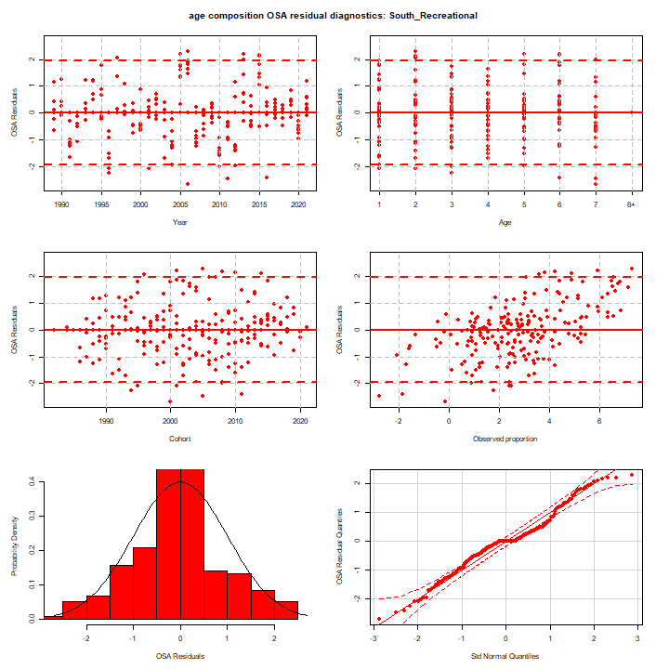
OSA Residuals
Run 25
Run 8

Slide 25

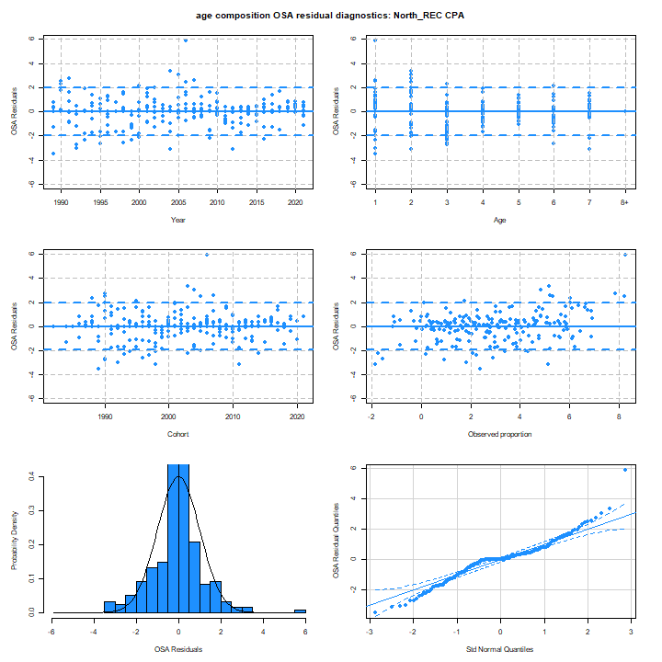
OSA Residuals
Run 25
Run 8

Slide 26
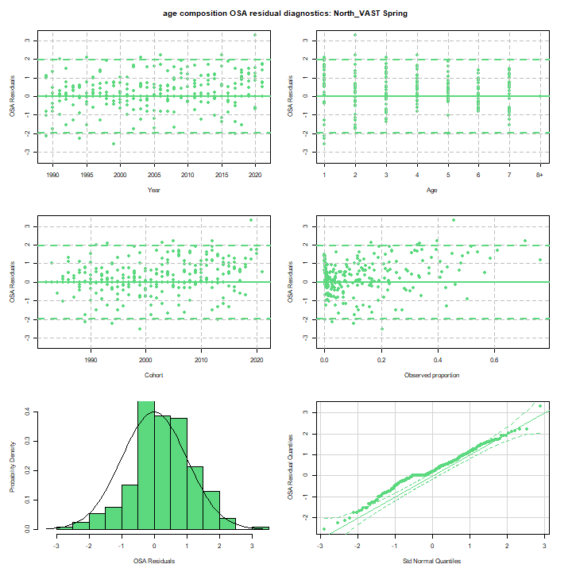

OSA Residuals
Run 25
Run 8

Slide 27
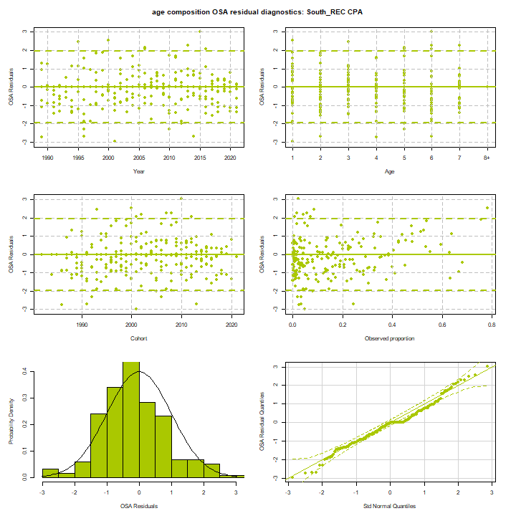
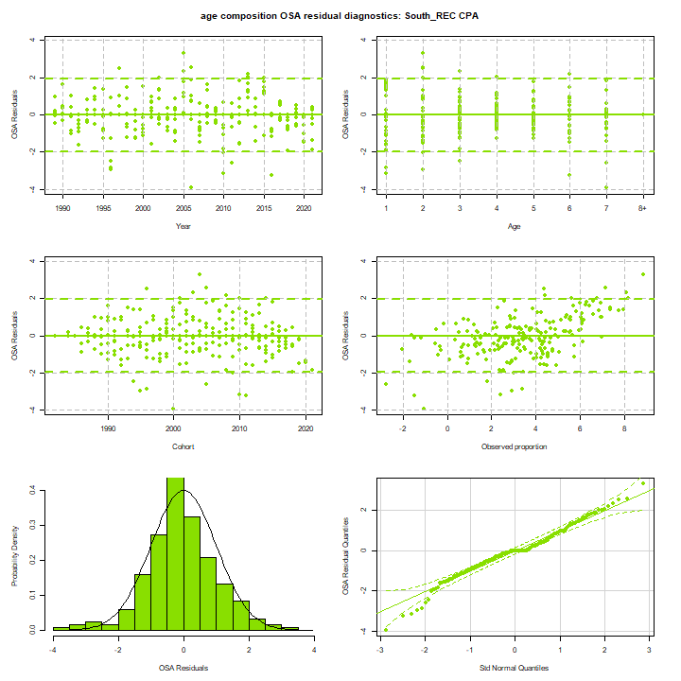
OSA Residuals
Run 25
Run 8

Slide 28
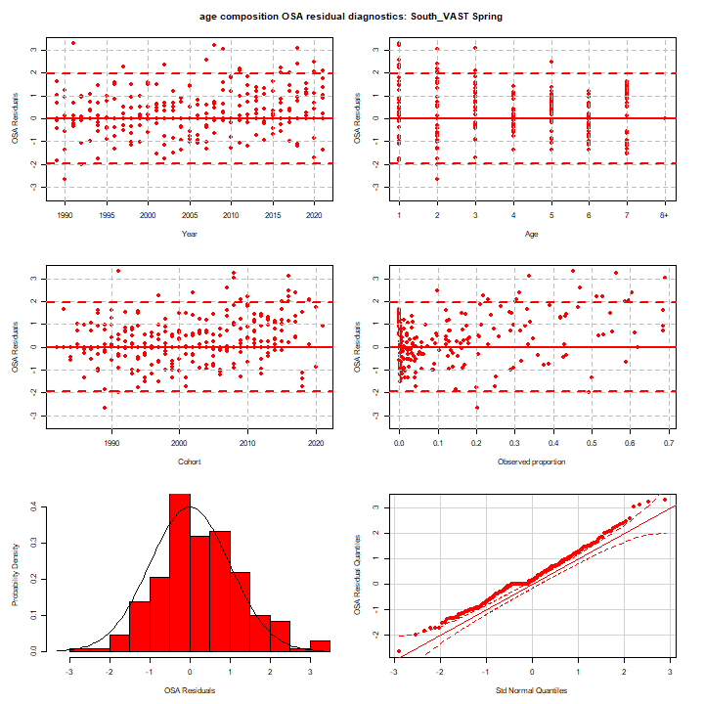

OSA Residuals
Run 25
Run 8

Slide 29
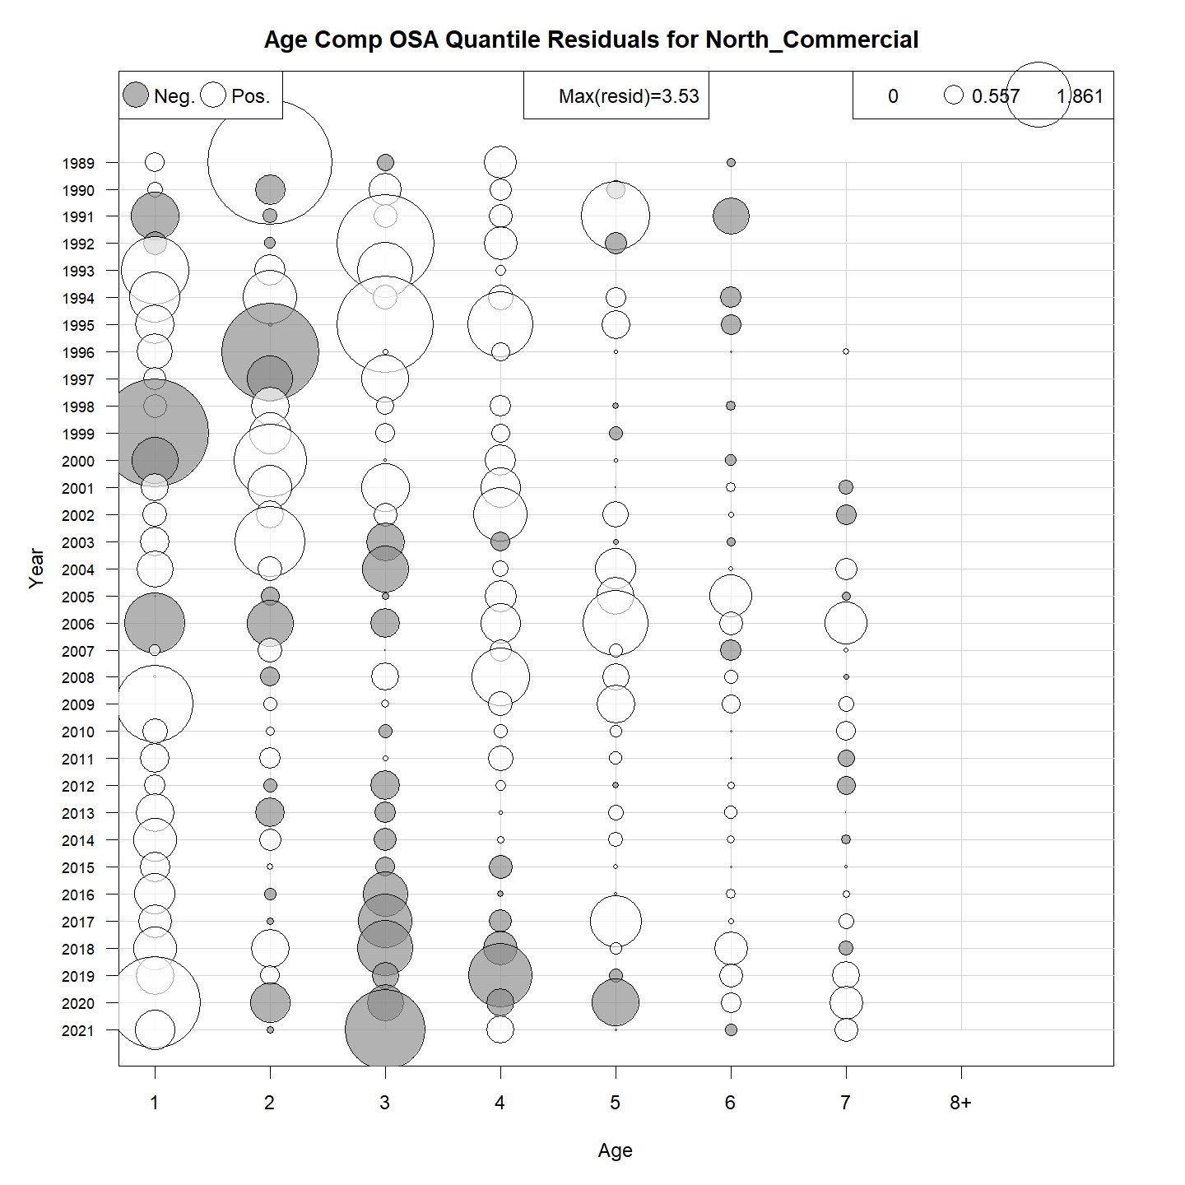
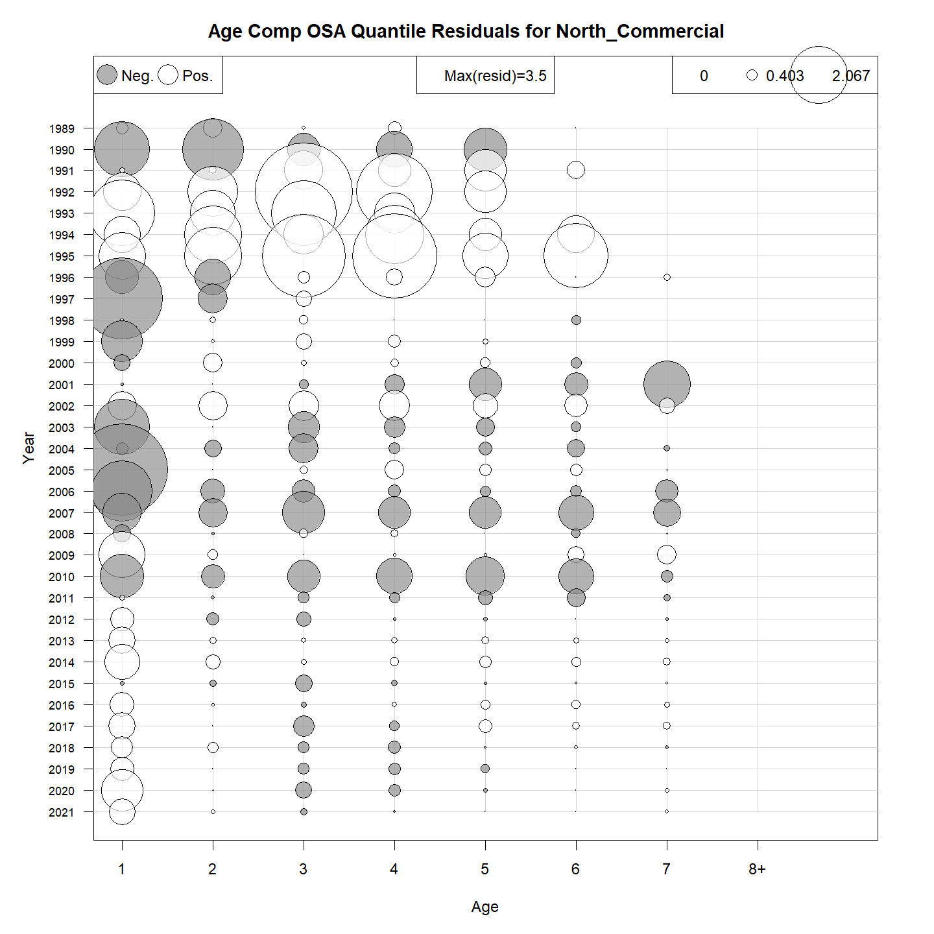
OSA Residuals
Run 25
Run 8

Slide 30
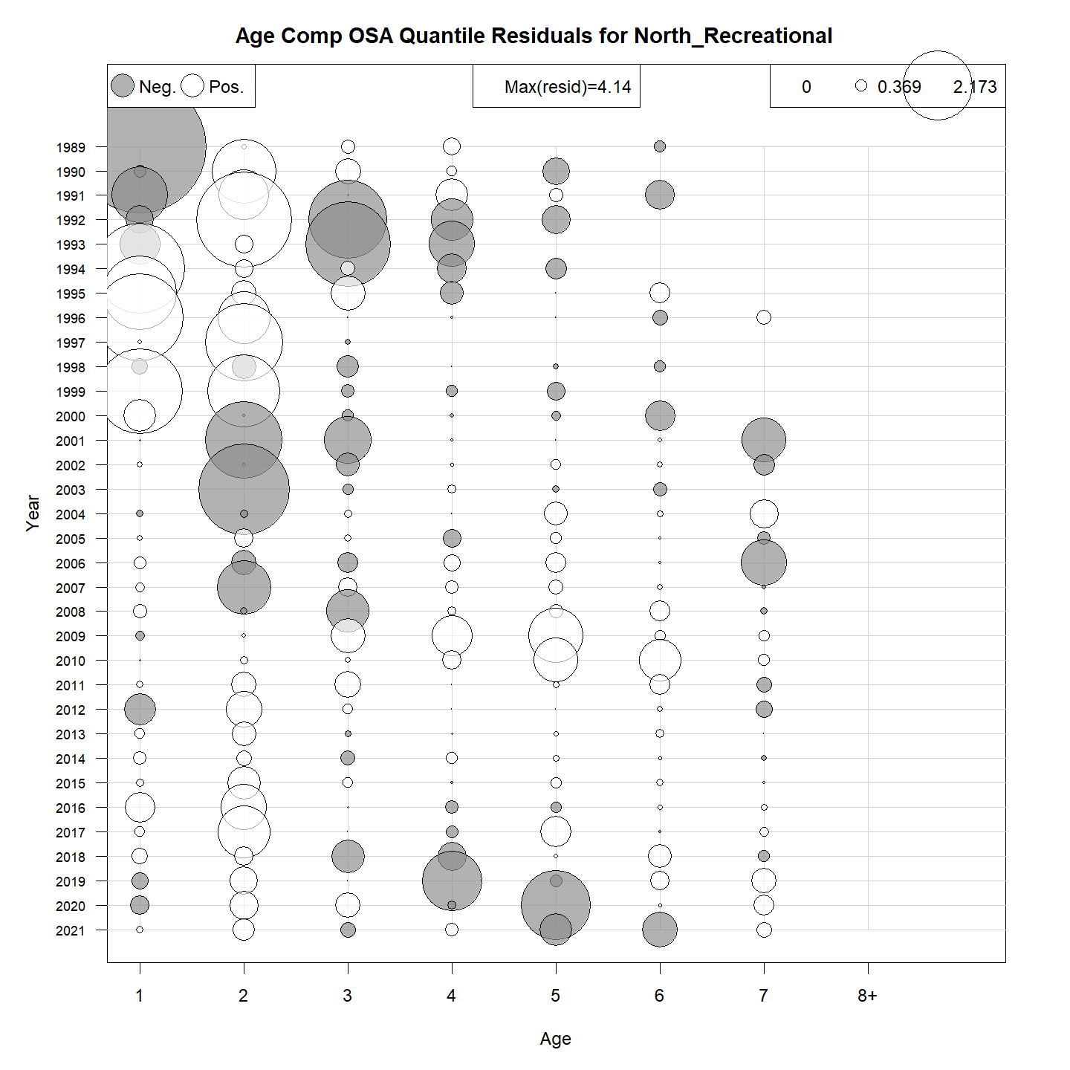
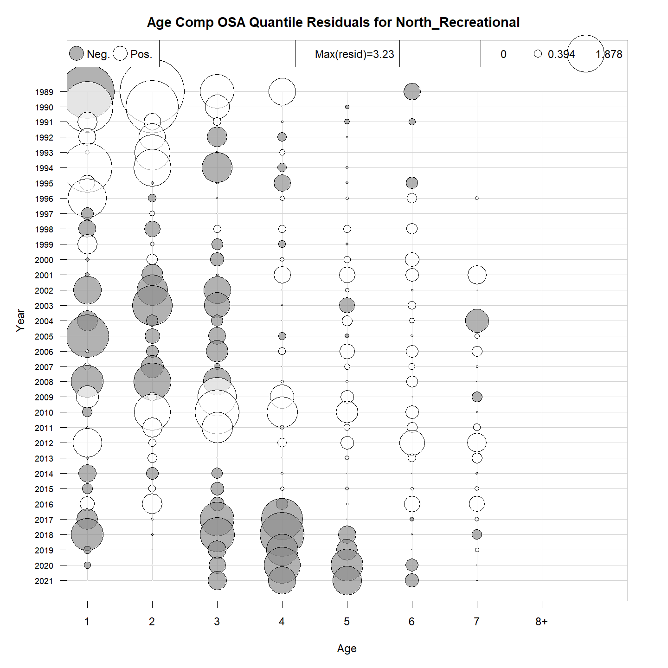
OSA Residuals
Run 25
Run 8

Slide 31


OSA Residuals
Run 25
Run 8

Slide 32


OSA Residuals
Run 25
Run 8

Slide 33


OSA Residuals
Run 25
Run 8

Slide 34


OSA Residuals
Run 25
Run 8

Slide 35


OSA Residuals
Run 25
Run 8

Slide 36


OSA Residuals
Run 25
Run 8

